Slide 1
Installation Guide to FreeMASTER 3.2
McMaster Automotive Resource Centre (MARC)
Notes:
Matlab Installing Tutorial – another section in the same PowerPoint

Slide 2
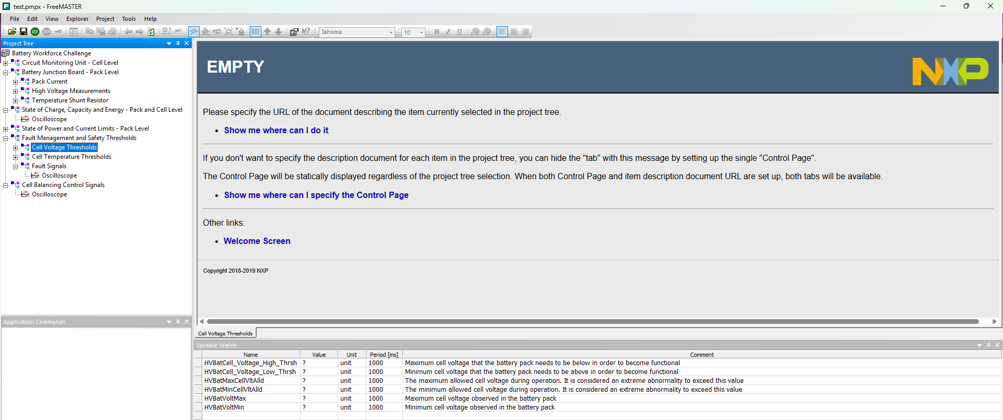
Installation Guide to FreeMASTER 3.2
Introduction to FreeMASTER
FreeMASTER is a real-time data visualization GUI and debugging tool developed by NXP for embedded systems.
It allows developers to monitor variables, tune parameters, and log data from microcontrollers without halting program execution.
Notes:
FreeMASTER User Guide: https://www.nxp.com/webapp/Download?colCode=FMSTERUG&isHTMLorPDF=HTML

Slide 3
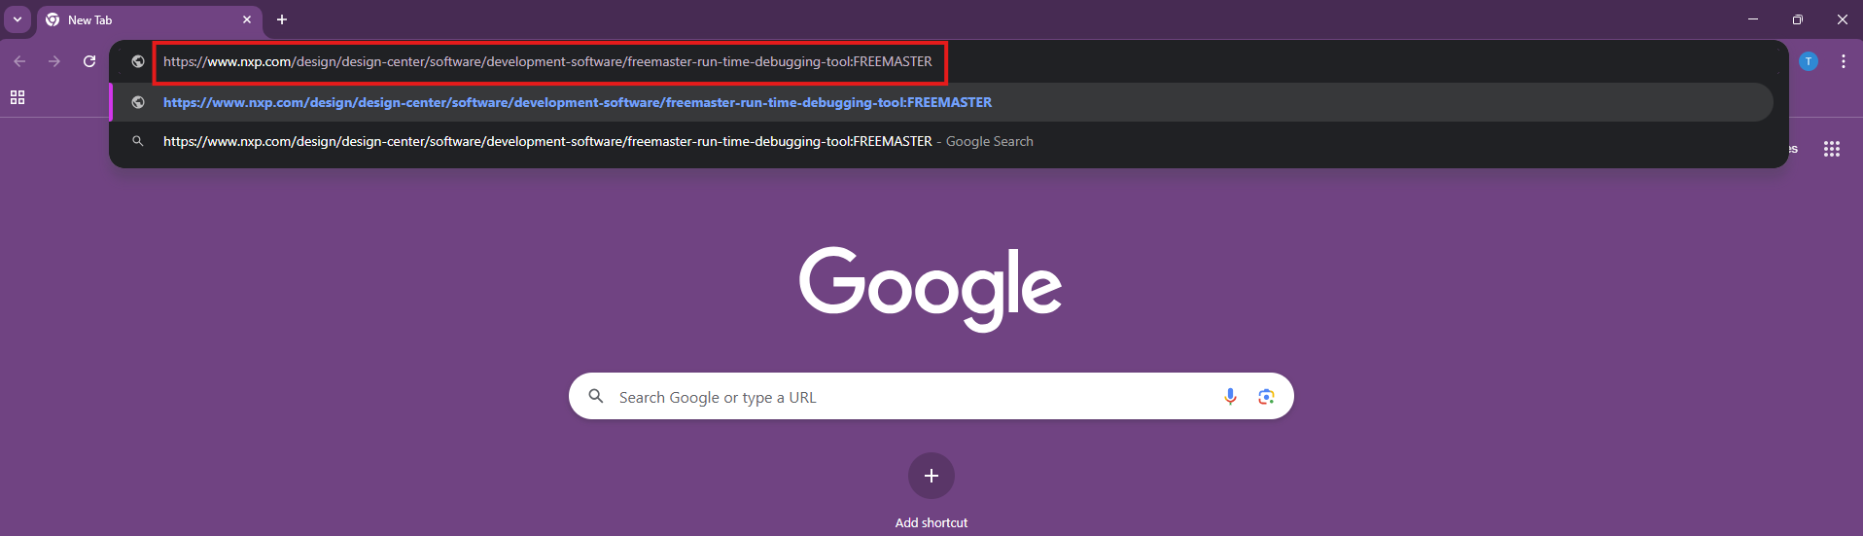
Installation Guide to FreeMASTER 3.2
Installation Steps
Search for https://www.nxp.com/design/design-center/software/development-software/freemaster-run-time-debugging-tool:FREEMASTER on your web browser.

Slide 4
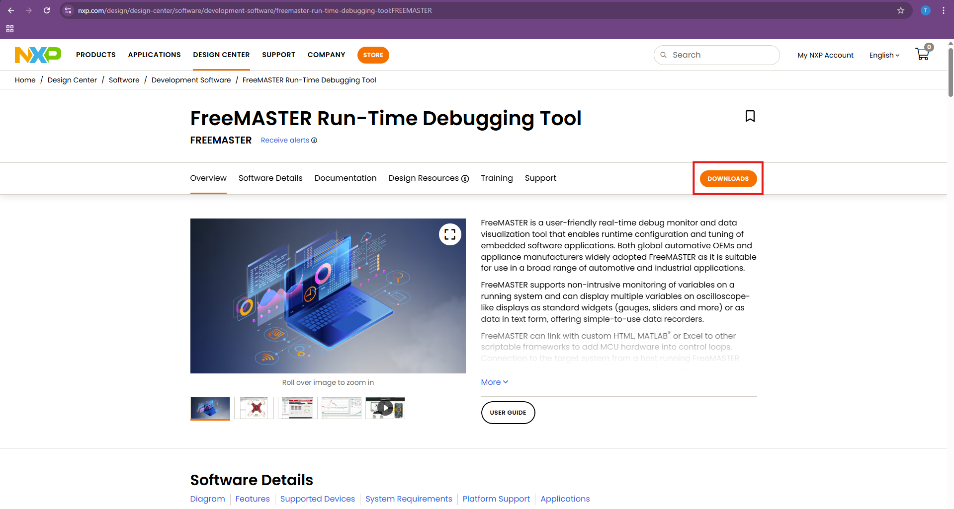
Installation Guide to FreeMASTER 3.2
Installation Steps
2. Press Downloads in the this FreeMASTER Run-Time Debugging Tool page.

Slide 5
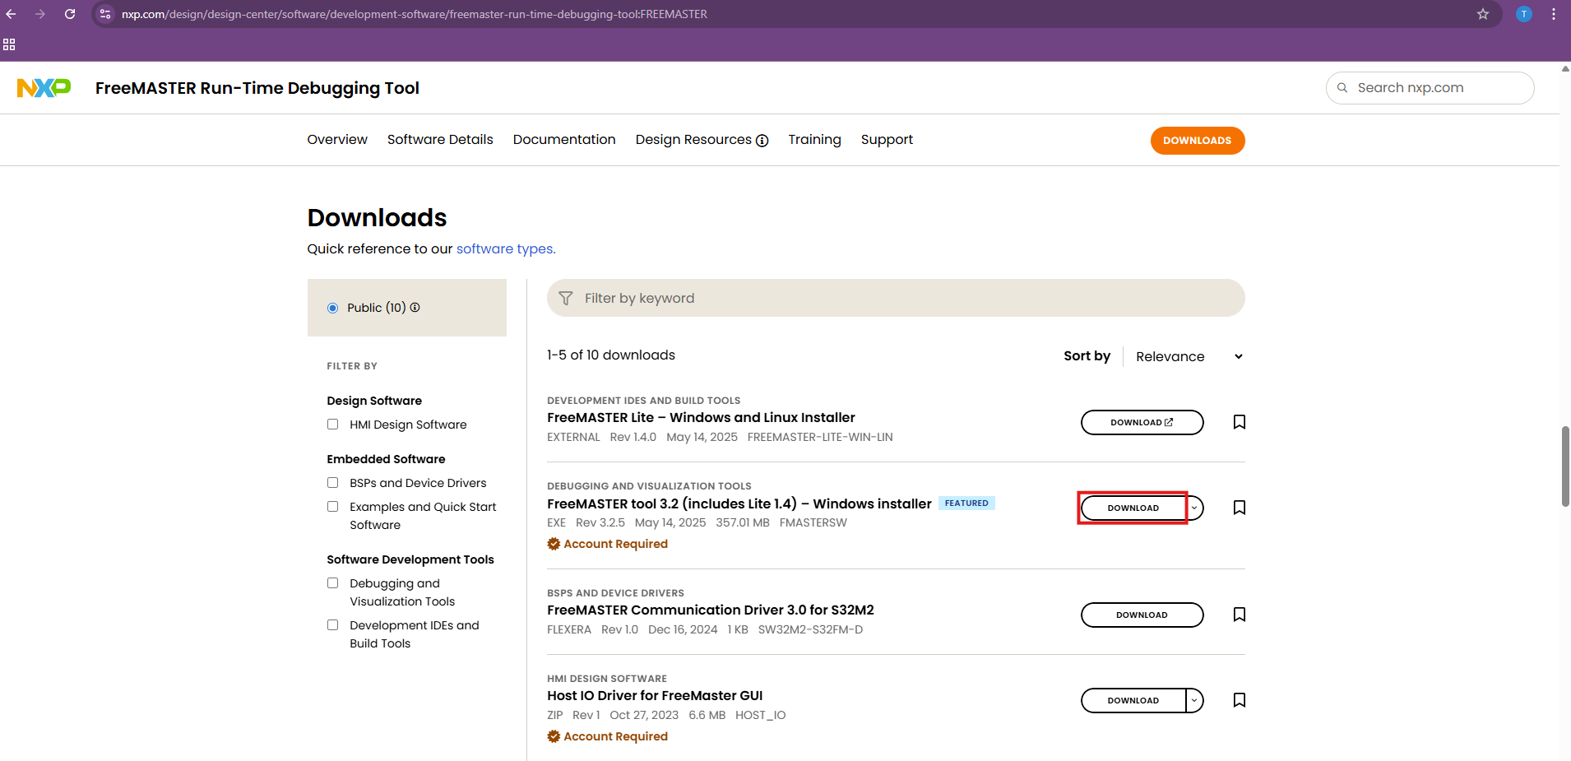
Installation Guide to FreeMASTER 3.2
Installation Steps
3. Press Download button next to FreeMASTER tool 3.2

Slide 6
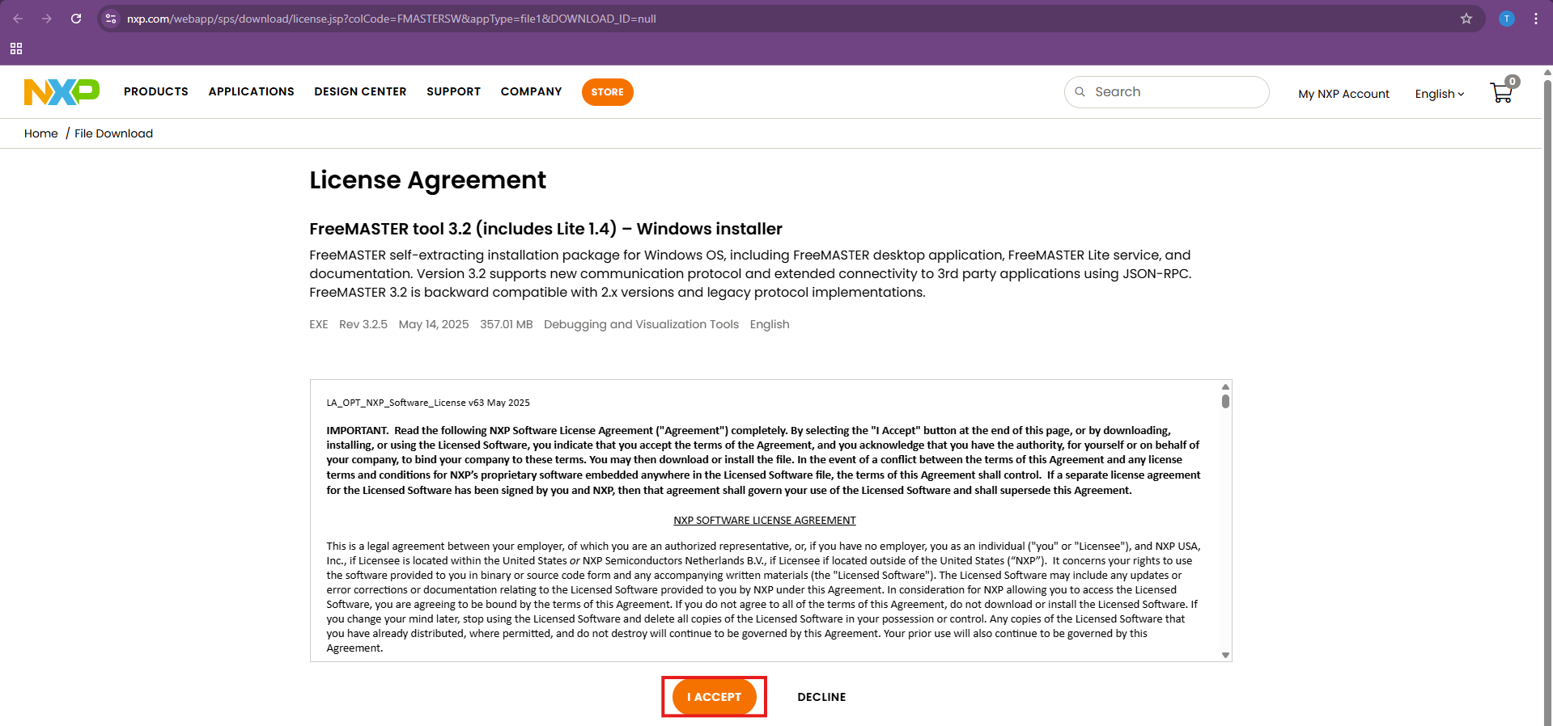
Installation Guide to FreeMASTER 3.2
Installation Steps
4. In the License Agreement page, press I Accept.

Slide 7
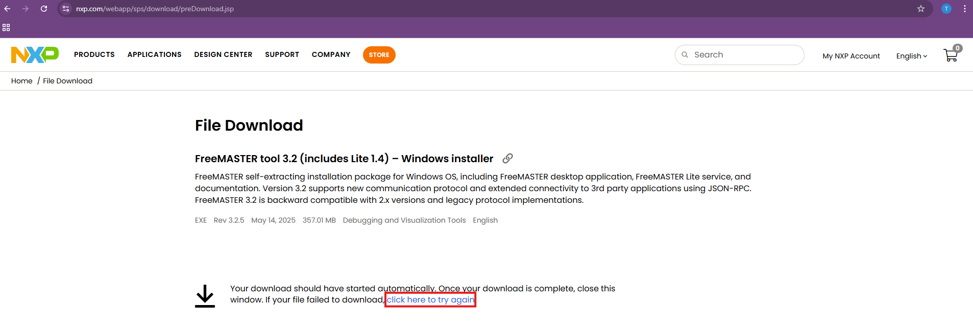
Installation Guide to FreeMASTER 3.2
Installation Steps
5. If the download does not start automatically, click on the click here to try again link.

Slide 8
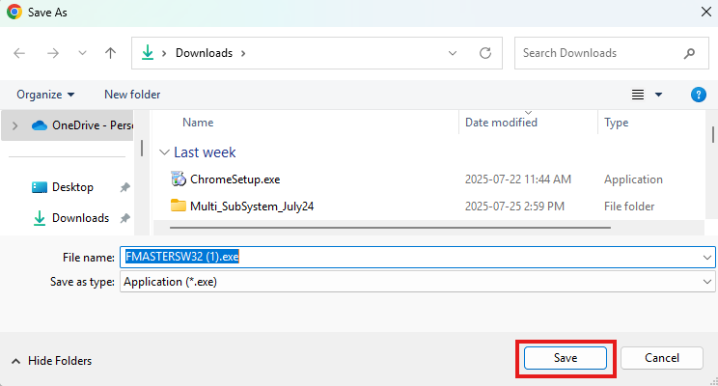
Installation Guide to FreeMASTER 3.2
Installation Steps
6. In the File Explorer pop-up window, save the executable file.

Slide 9
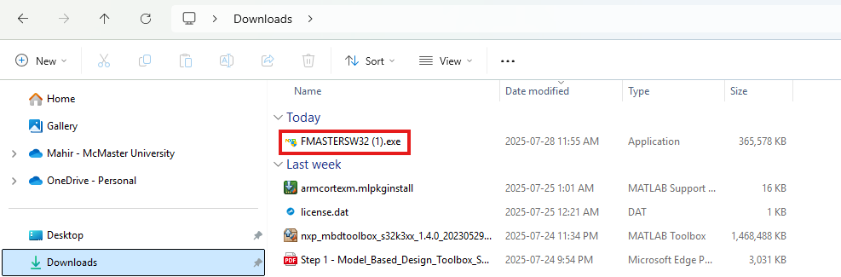
Installation Guide to FreeMASTER 3.2
Installation Steps
7. Open it by double-clicking.

Slide 10
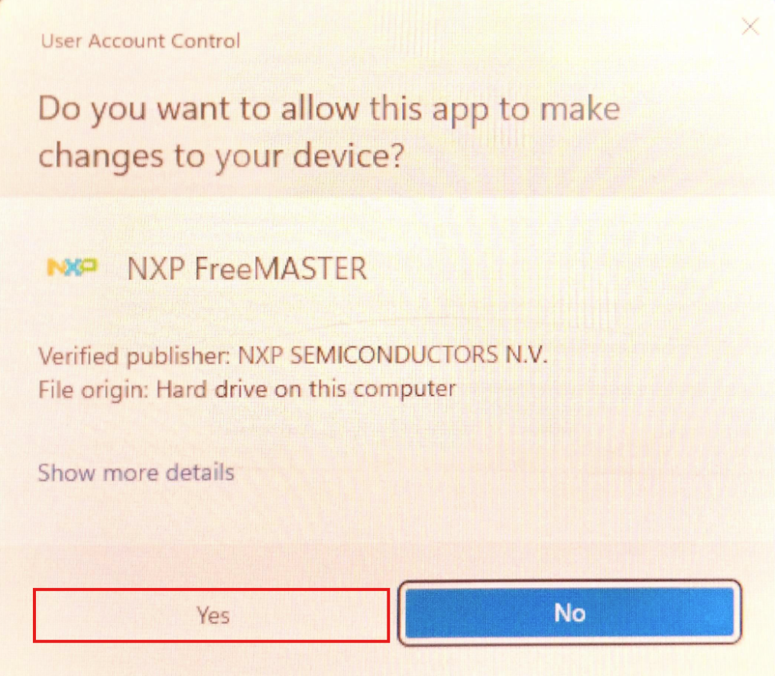
Installation Guide to FreeMASTER 3.2
Installation Steps
8. In the pop-up window of “Do you want to allow this app to make changes to your device?”, press yes.

Slide 11
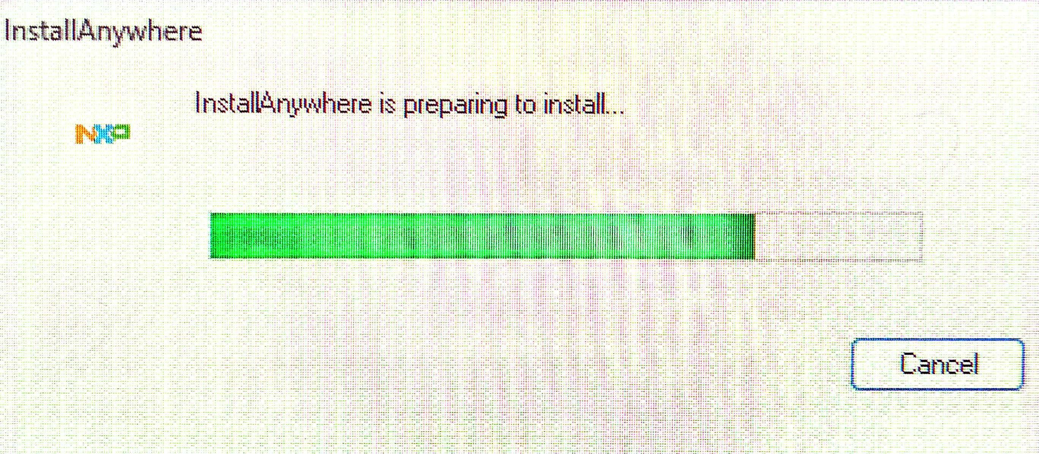
Installation Guide to FreeMASTER 3.2
Installation Steps
9. Please wait for a few seconds while the installation is getting ready.

Slide 12
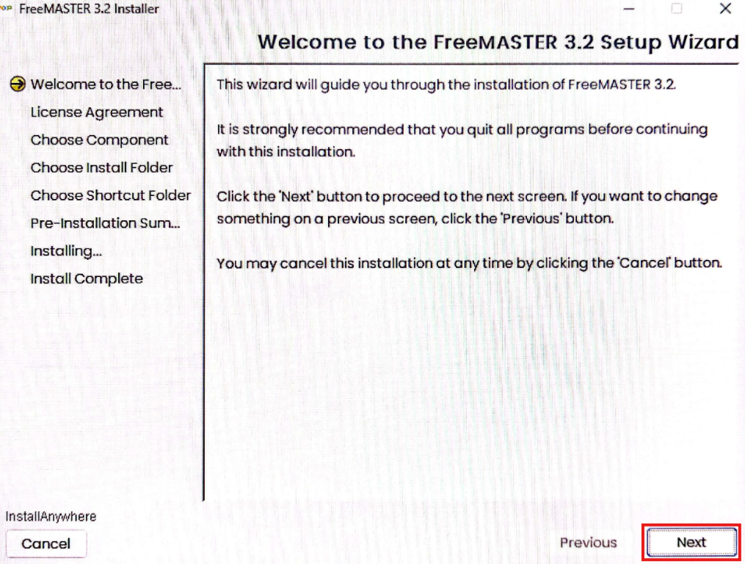
Installation Guide to FreeMASTER 3.2
Installation Steps
10. In the new FreeMASTER 3.2 Installation window, press Next.

Slide 13
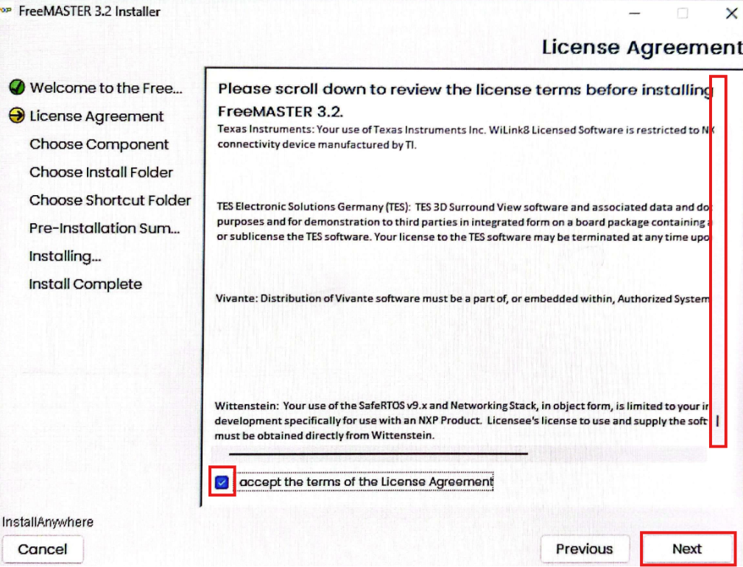
Installation Guide to FreeMASTER 3.2
Installation Steps
11. In the License Agreement page, scroll all the way down, then check off I accept the terms of the License Agreement and press Next.

Slide 14
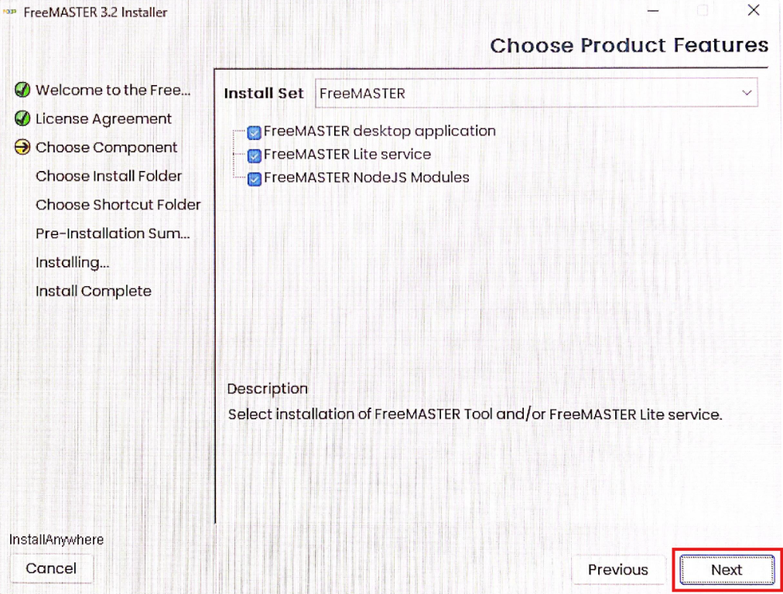
Installation Guide to FreeMASTER 3.2
Installation Steps
12. In the Choose Product Features page, press Next.

Slide 15
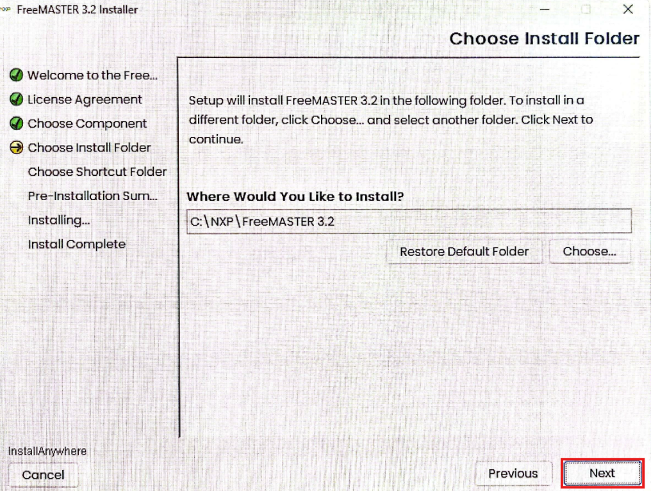
Installation Guide to FreeMASTER 3.2
Installation Steps
13. In the Choose Install Folder page, press Next.

Slide 16
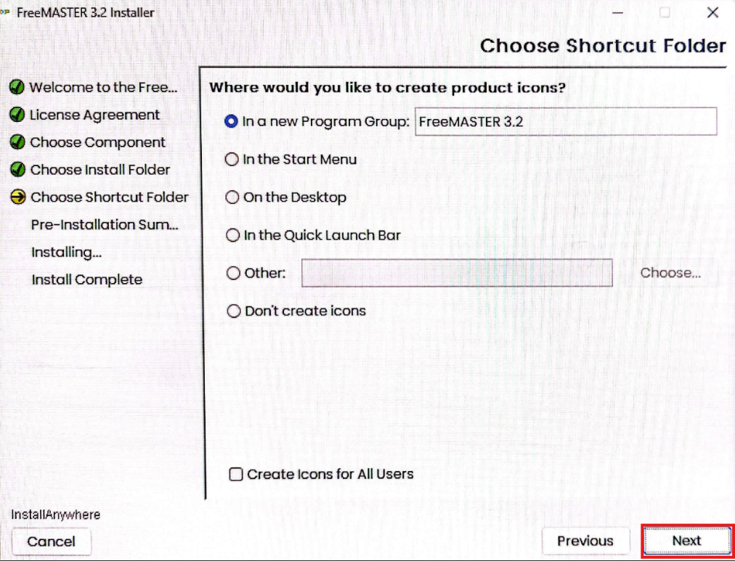
Installation Guide to FreeMASTER 3.2
Installation Steps
14. In the Choose Shortcut Folder page, press Next.

Slide 17
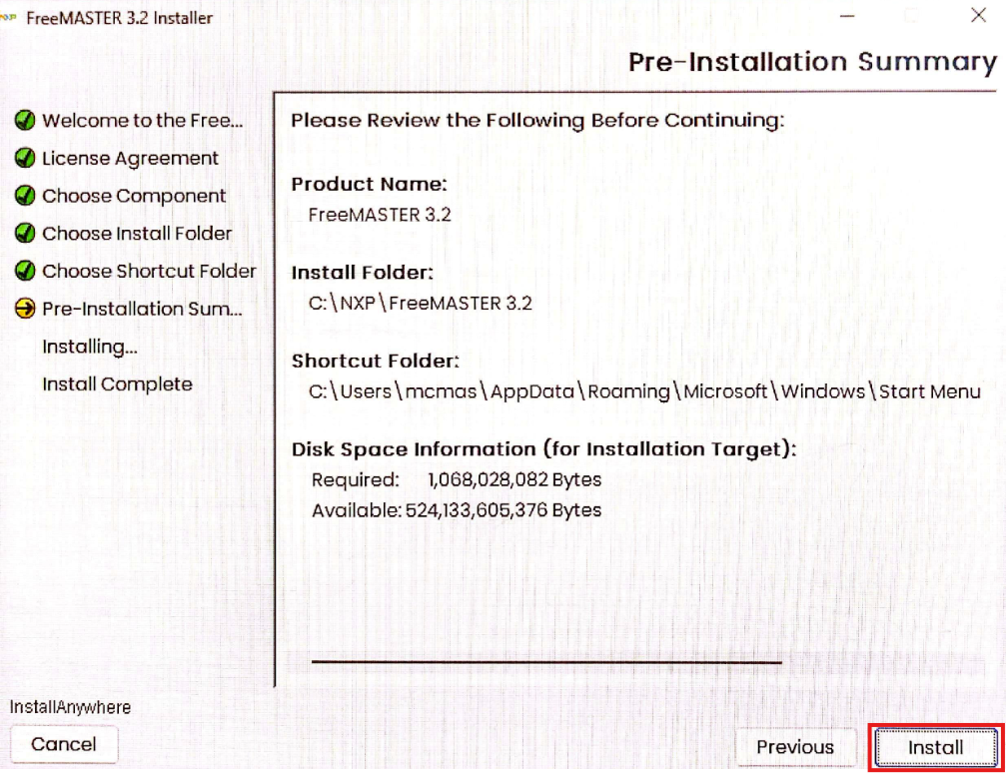
Installation Guide to FreeMASTER 3.2
Installation Steps
15. In the Pre-Installation Summary page, press Install.

Slide 18
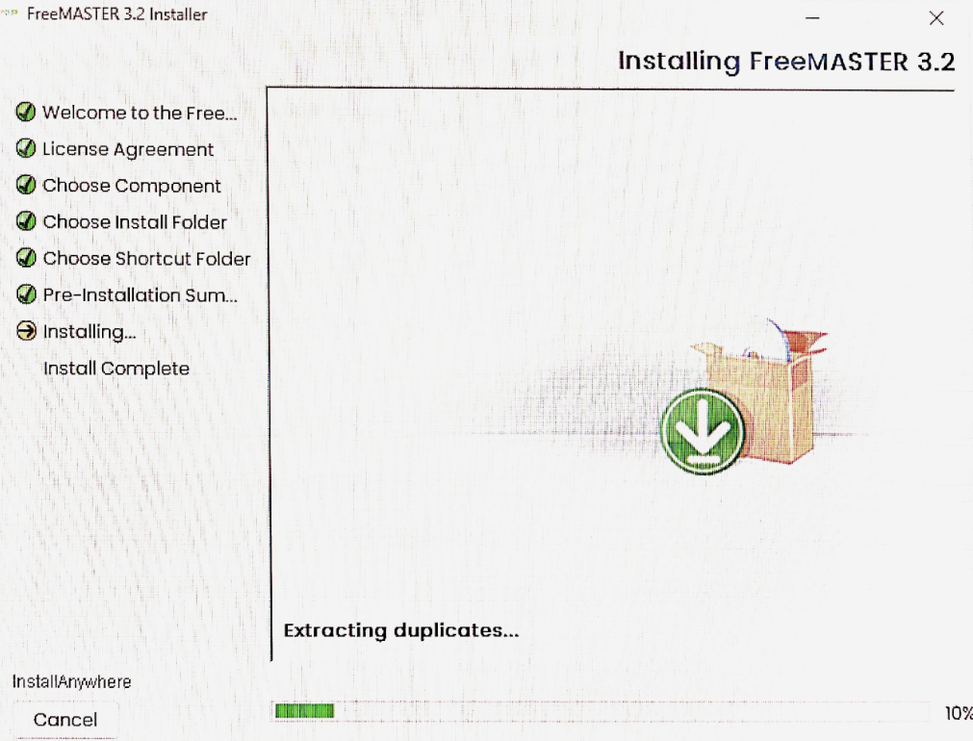
Installation Guide to FreeMASTER 3.2
Installation Steps
16. Wait for a few minutes/seconds until the installation is over.

Slide 19
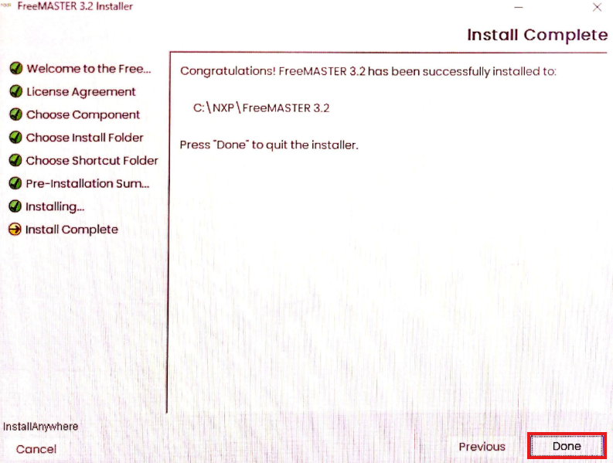
Installation Guide to FreeMASTER 3.2
Installation Steps
17. In the Install Complete page, press Done.

Slide 20
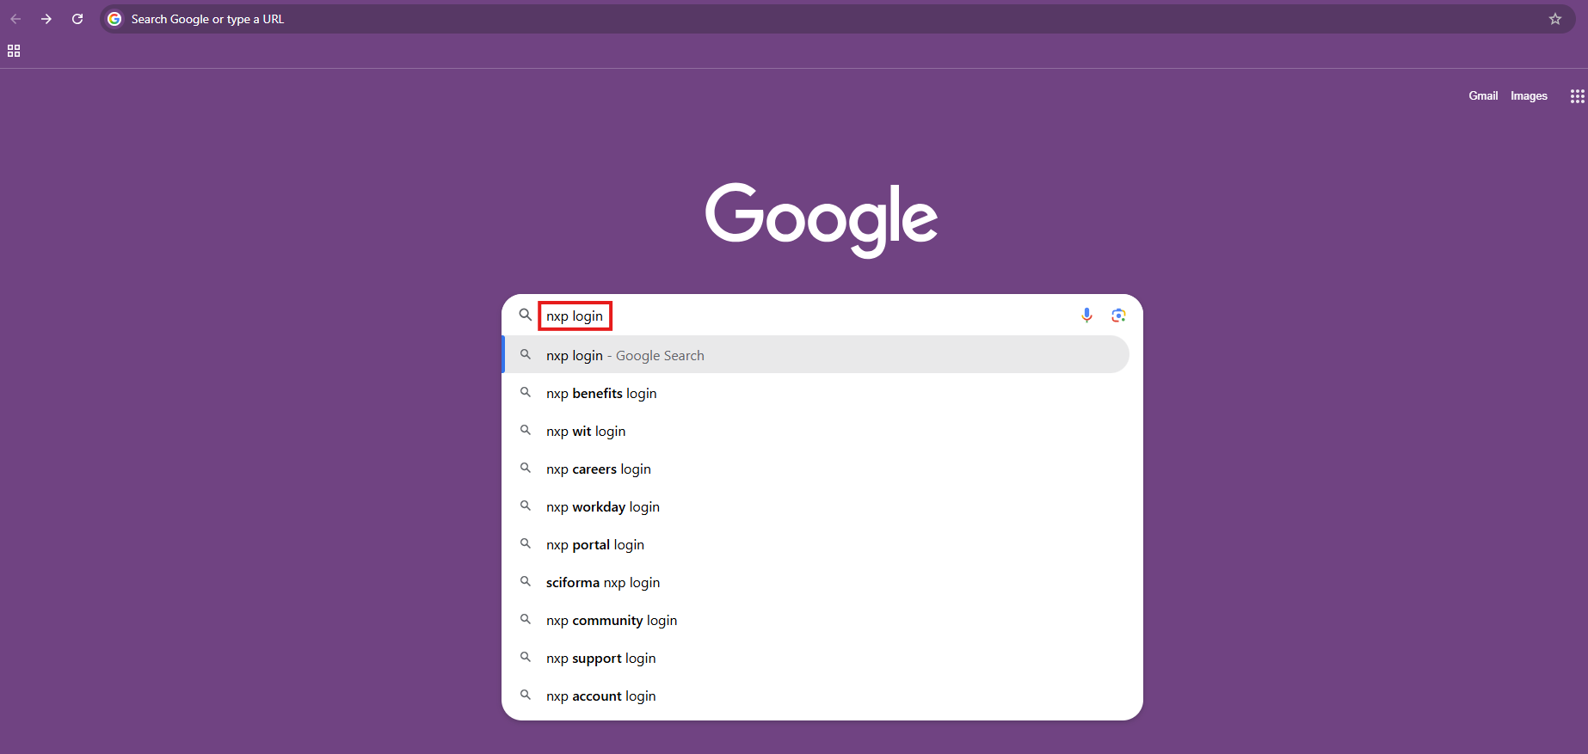
Installation Guide to FreeMASTER 3.2
Get and Activate License (Only for FreeMaster Lite)
Search for NXP login to your web browser.

Slide 21
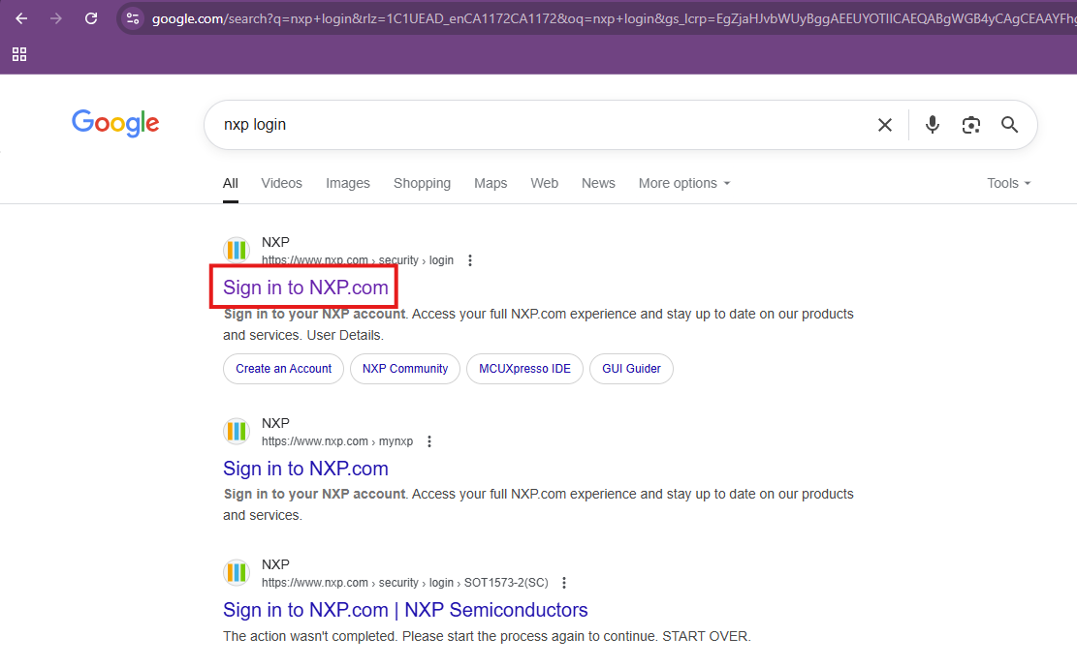
Installation Guide to FreeMASTER 3.2
Get and Activate License (Only for FreeMaster Lite)
Click on the first search result link Sign in to NXP.com.

Slide 22
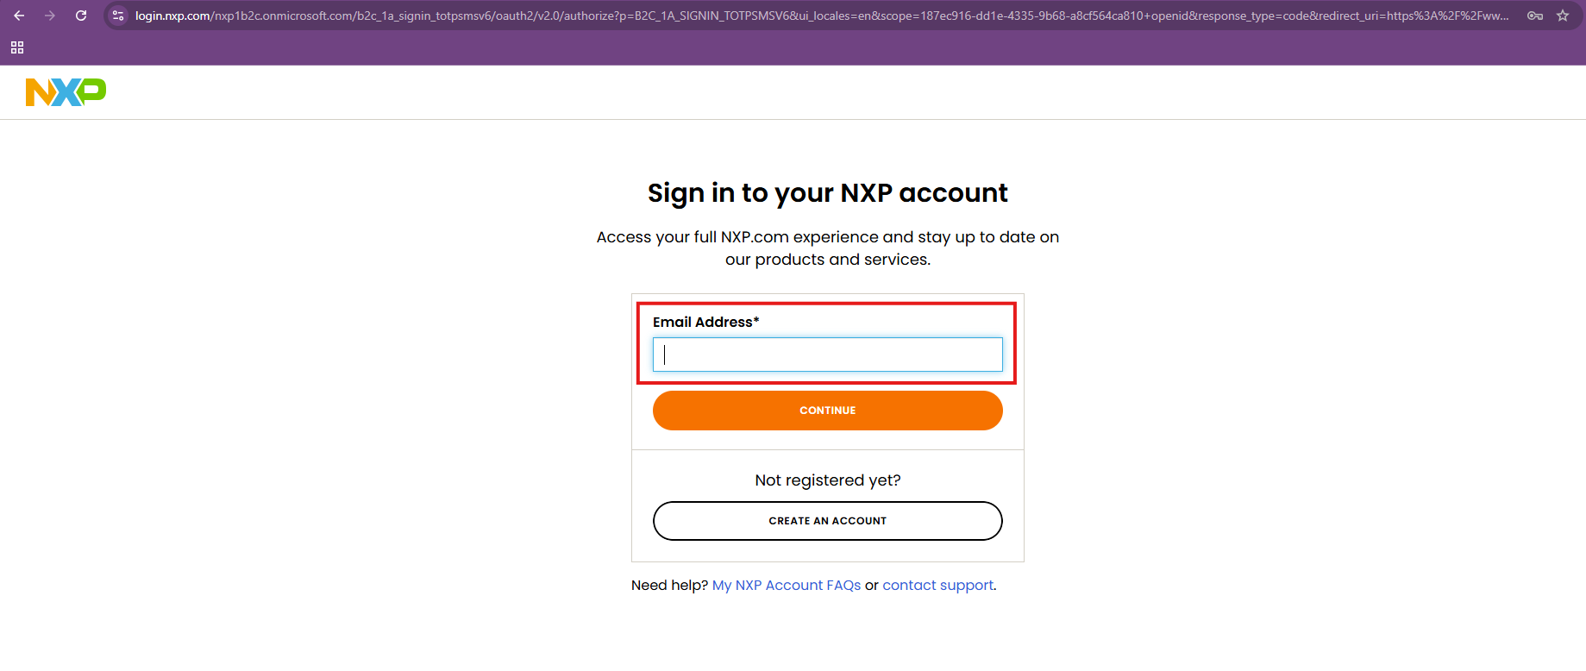
Installation Guide to FreeMASTER 3.2
Get and Activate License (Only for FreeMaster Lite)
Sign in using the correct login credentials (correct email address and password).

Slide 23
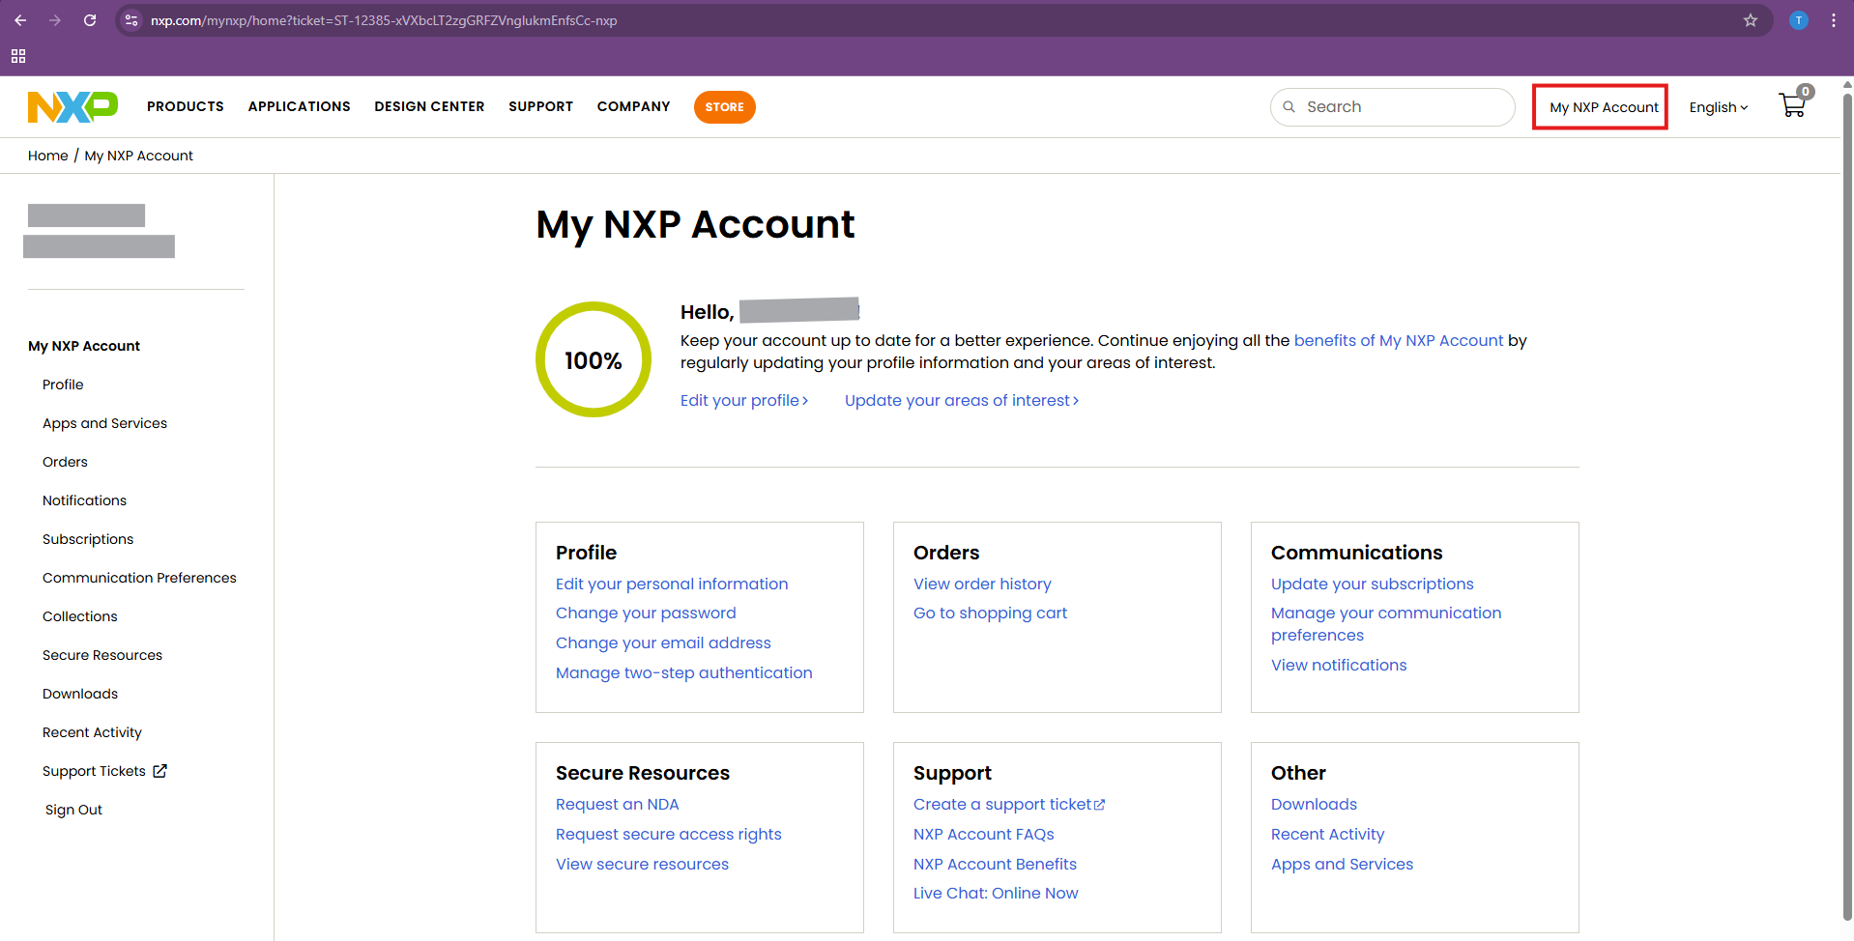
Installation Guide to FreeMASTER 3.2
Get and Activate License (Only for FreeMaster Lite)
After successful sign in, in the new page press My NXP Account from the top right corner.

Slide 24
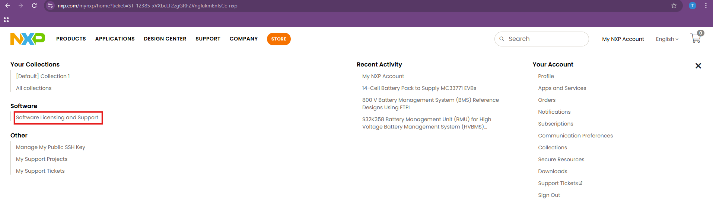
Installation Guide to FreeMASTER 3.2
Get and Activate License (Only for FreeMaster Lite)
Next click on Software Licensing and Support.

Slide 25
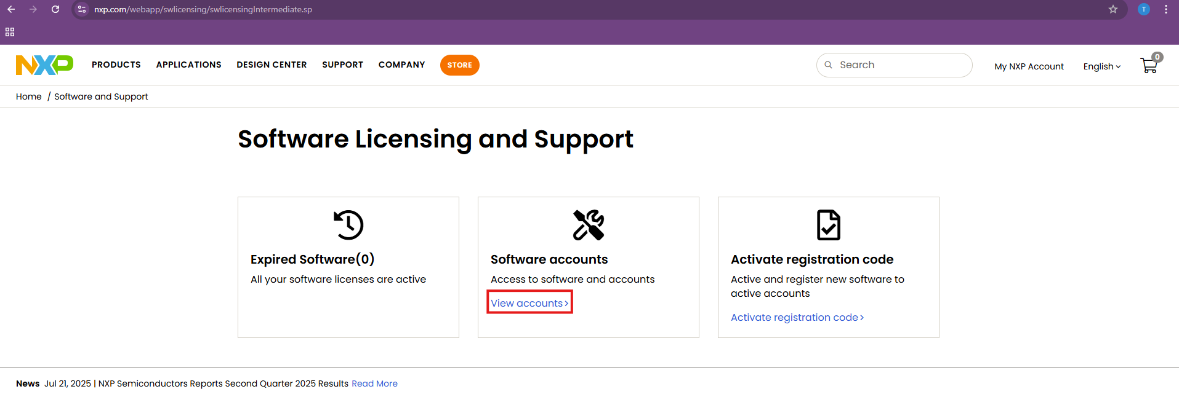
Installation Guide to FreeMASTER 3.2
Get and Activate License (Only for FreeMaster Lite)
In the next page, click on View accounts.

Slide 26
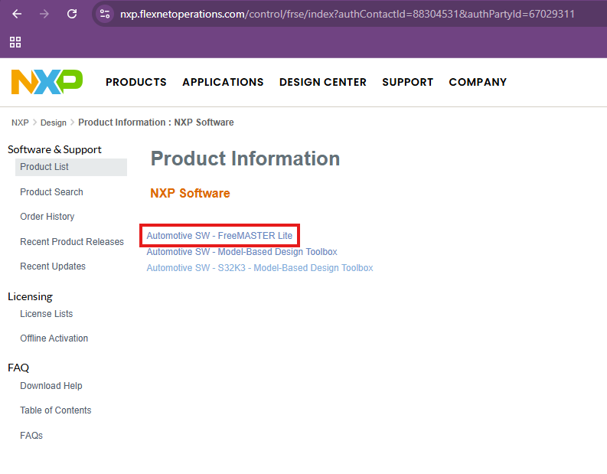
Installation Guide to FreeMASTER 3.2
Get and Activate License (Only for FreeMaster Lite)
In the next page, click on Automotive SW - FreeMASTER Lite.

Slide 27
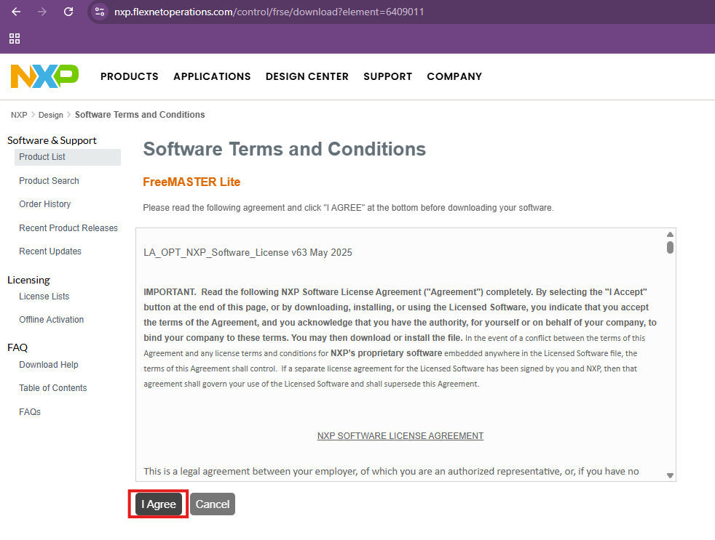
Installation Guide to FreeMASTER 3.2
Get and Activate License (Only for FreeMaster Lite)
In the next page, press I Agree.

Slide 28
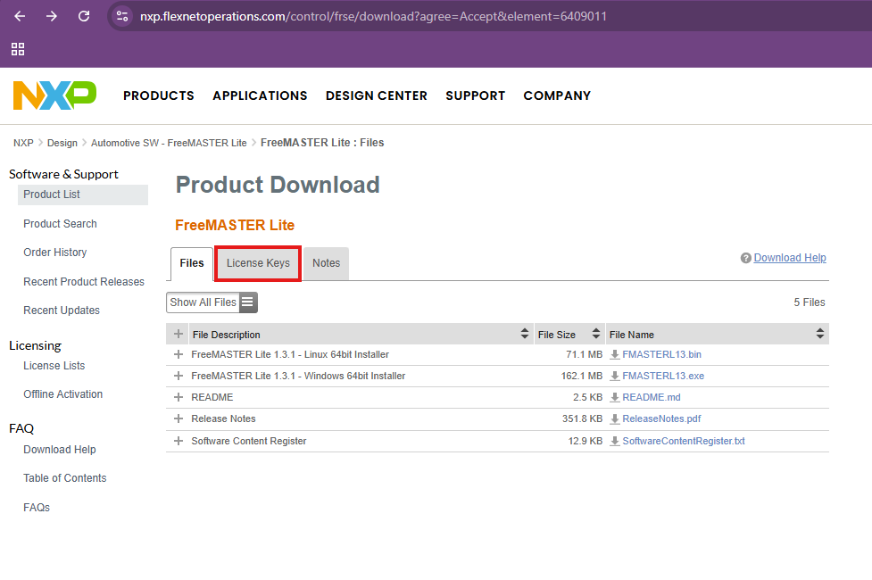
Installation Guide to FreeMASTER 3.2
Get and Activate License (Only for FreeMaster Lite)
In the next page, press License Keys which is the second tab on the top.

Slide 29
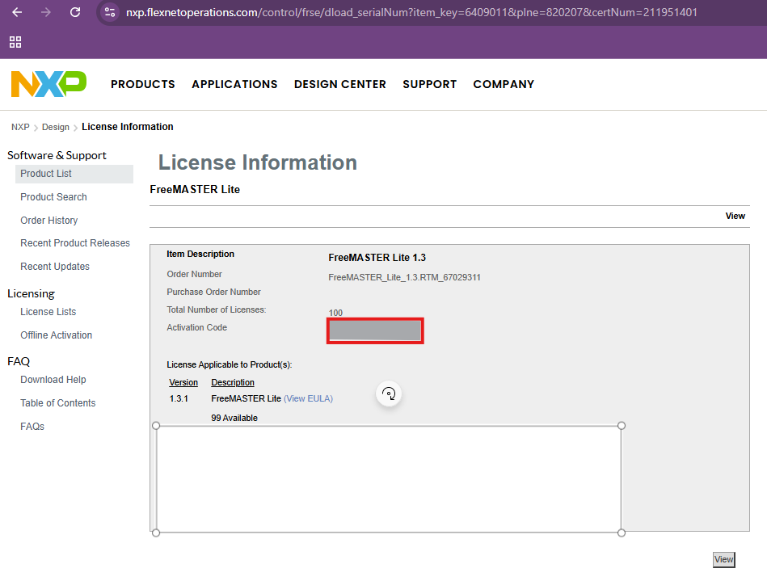
Installation Guide to FreeMASTER 3.2
Get and Activate License (Only for FreeMaster Lite)
From this License Information page, copy the activation code using ctrl+c.

Slide 30
Thank you
McMaster Automotive Resource Centre (MARC)
30

